Slide 1
Chess
Data Analysis and Winner prediction

Slide 2
Agenda
Lichess introduction
Dataset introduction
Important Features and visualizations
Logistic Regression
Univariate
Multivariate
Conclusions

Slide 3
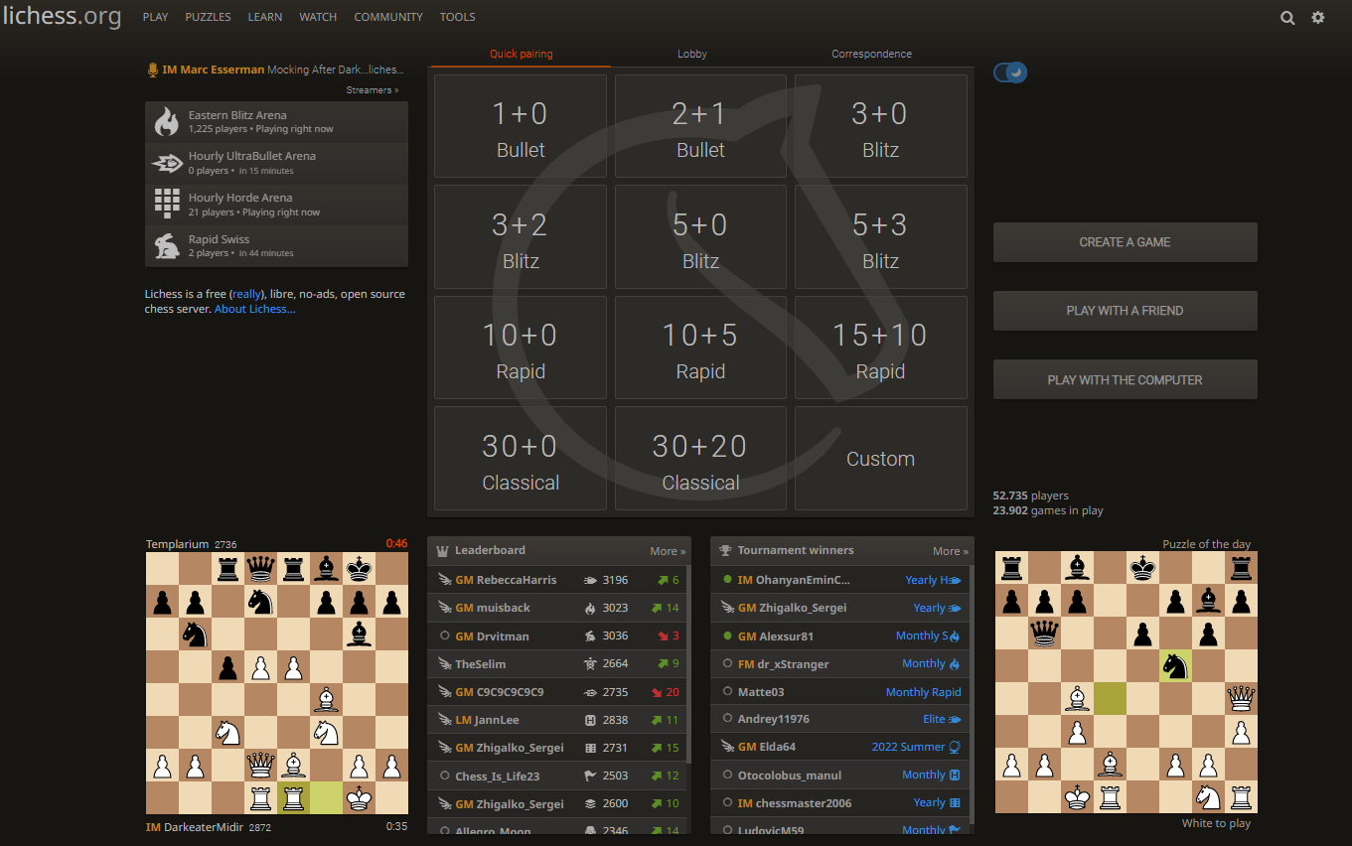
Lichess
https://lichess.org/ is a website to connect chess players over the globe to play chess in many ways.
Notes:
The match between players is based on the player rating.

Slide 4
Dataset
This is a set of just over 20,000 games (Data points) collected from a selection of users on the site Lichess.org
This set contains the:
Game ID;
Rated (T/F);
Start Time;
End Time;
Number of Turns;
Game Status;
Winner;
Time Increment;
White Player ID;
White Player Rating;
Black Player ID;
Black Player Rating;
All Moves in Standard Chess Notation;
Opening Eco (Standardised Code for any given opening, list here);
Opening Name;
Opening Ply (Number of moves in the opening phase)
Notes:
In the next slides we will go through the most important features of the dataset

Slide 5
Conclusions and Results
Our Model has an accuracy of 66%
We have successfully improved the model from 50 % accuracy to 66% by using a multivariate logistic regression Model.
Lichess.org increased 300% its visitors and games from 2016 to 2017
Players resigns before checkmate.
There is a small deviation between games won with White than Black
There a players who are better playing with whites and players who are better playing with black
There are more than 1400 different openings used by players.

Slide 6
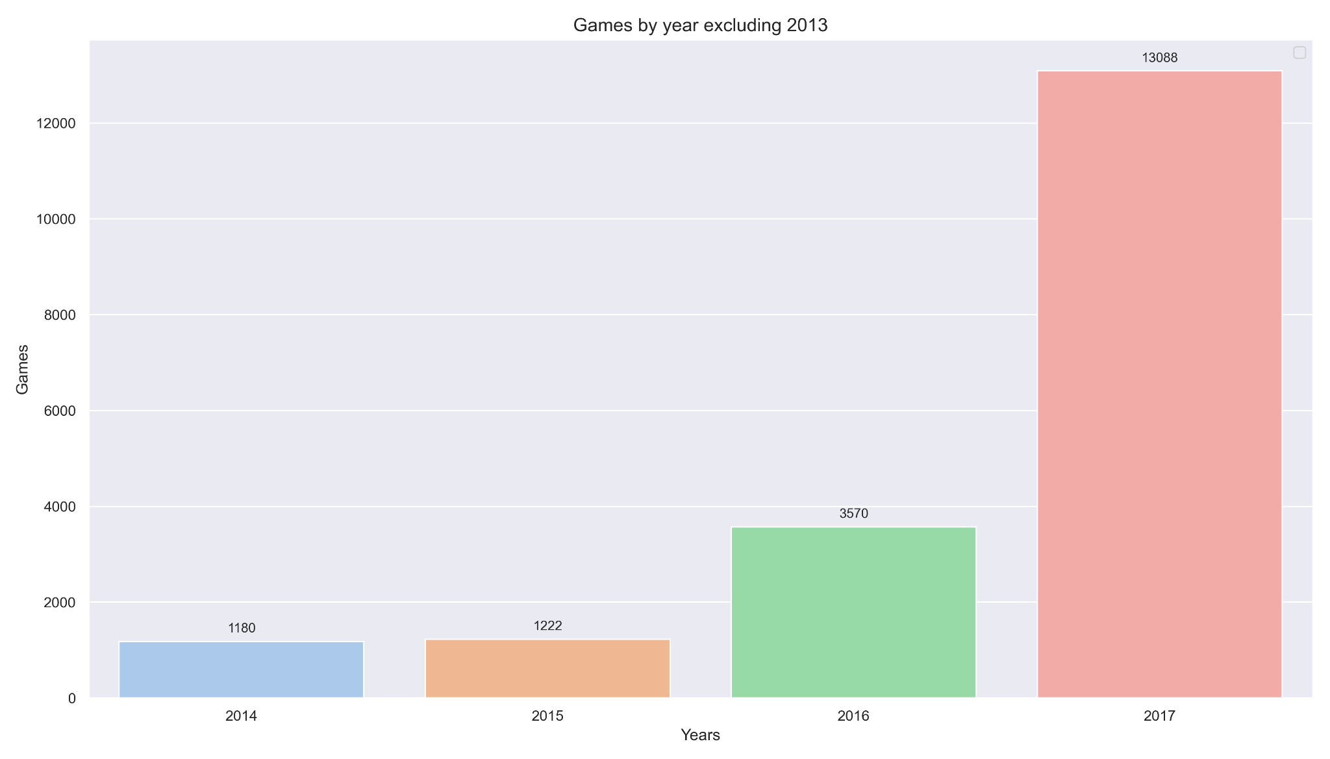
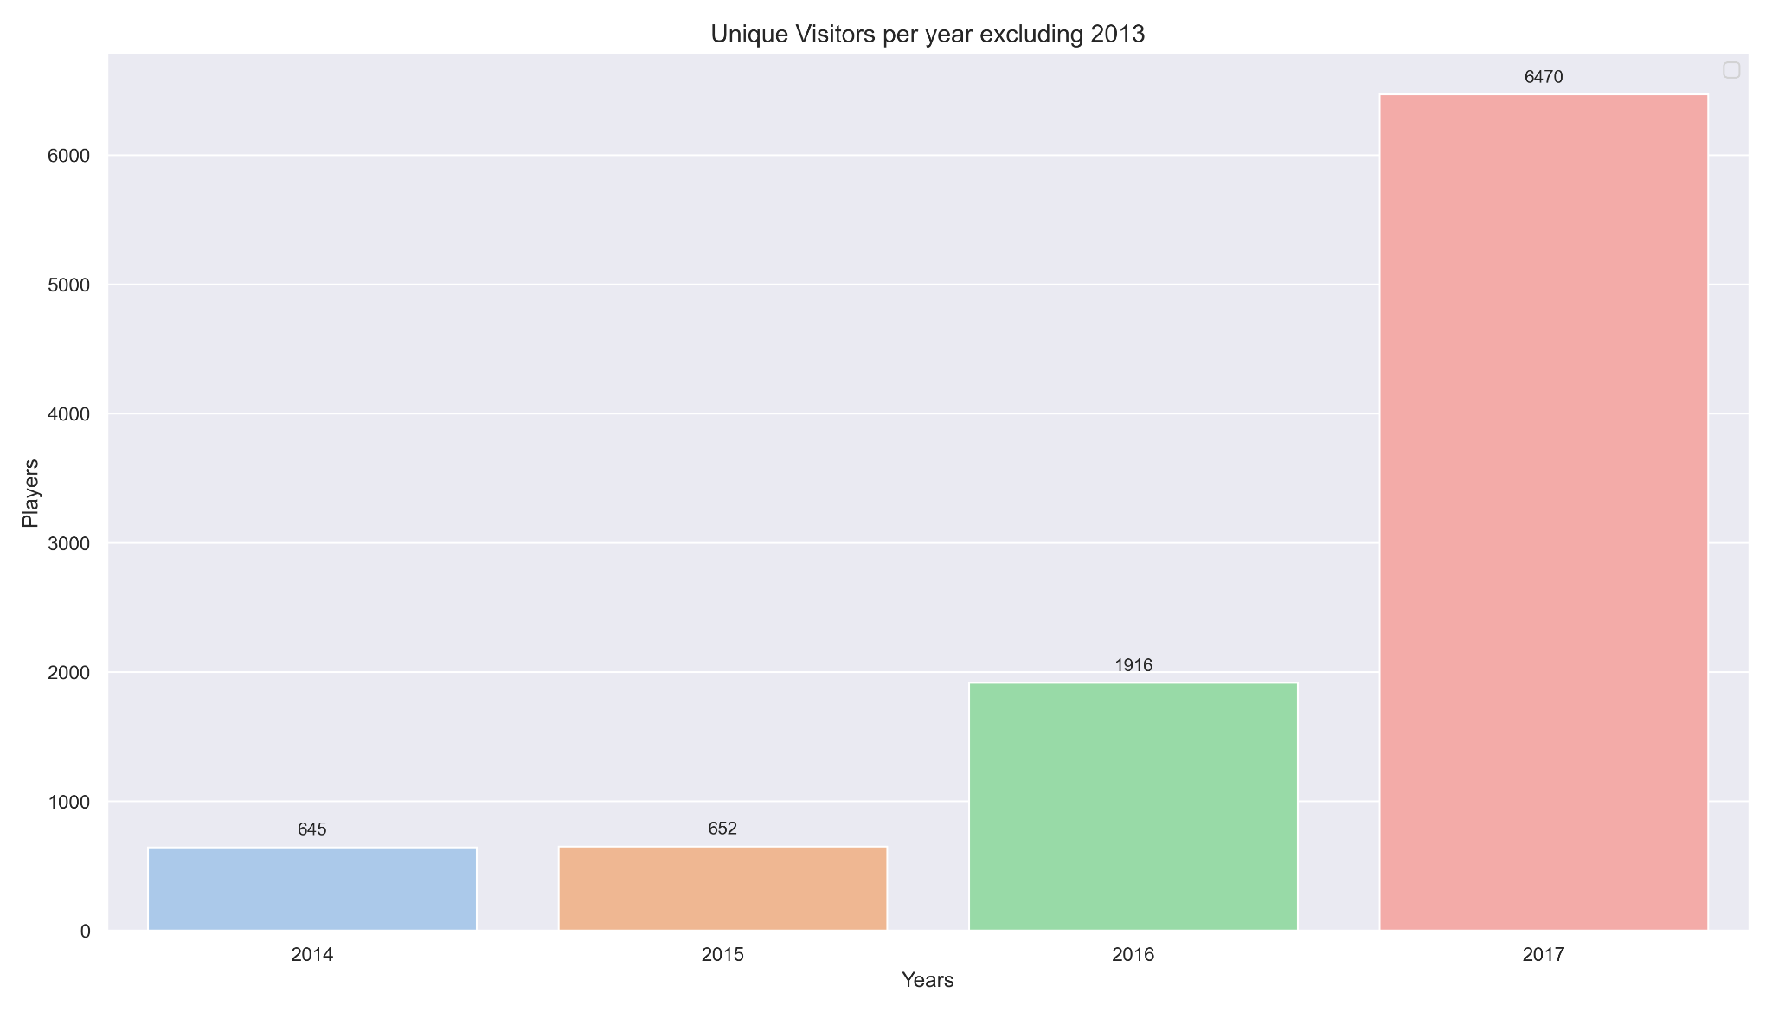
Games and Players by year
Unique visitors and games by year had an increase bigger than 300% between 2016 and 2017

Slide 7
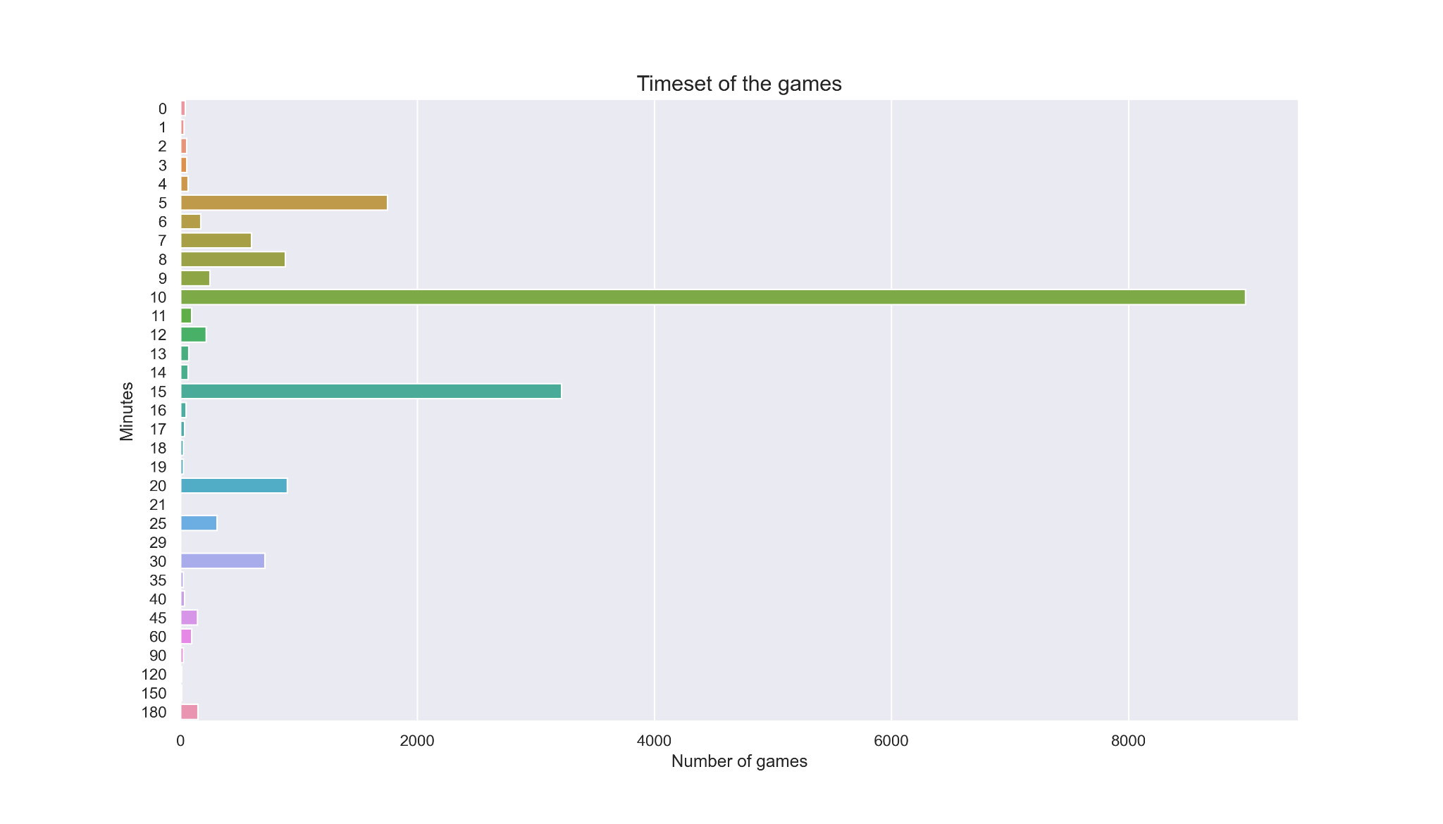
Duration selected for the games
Most of the games are set to last 10 min.

Slide 8
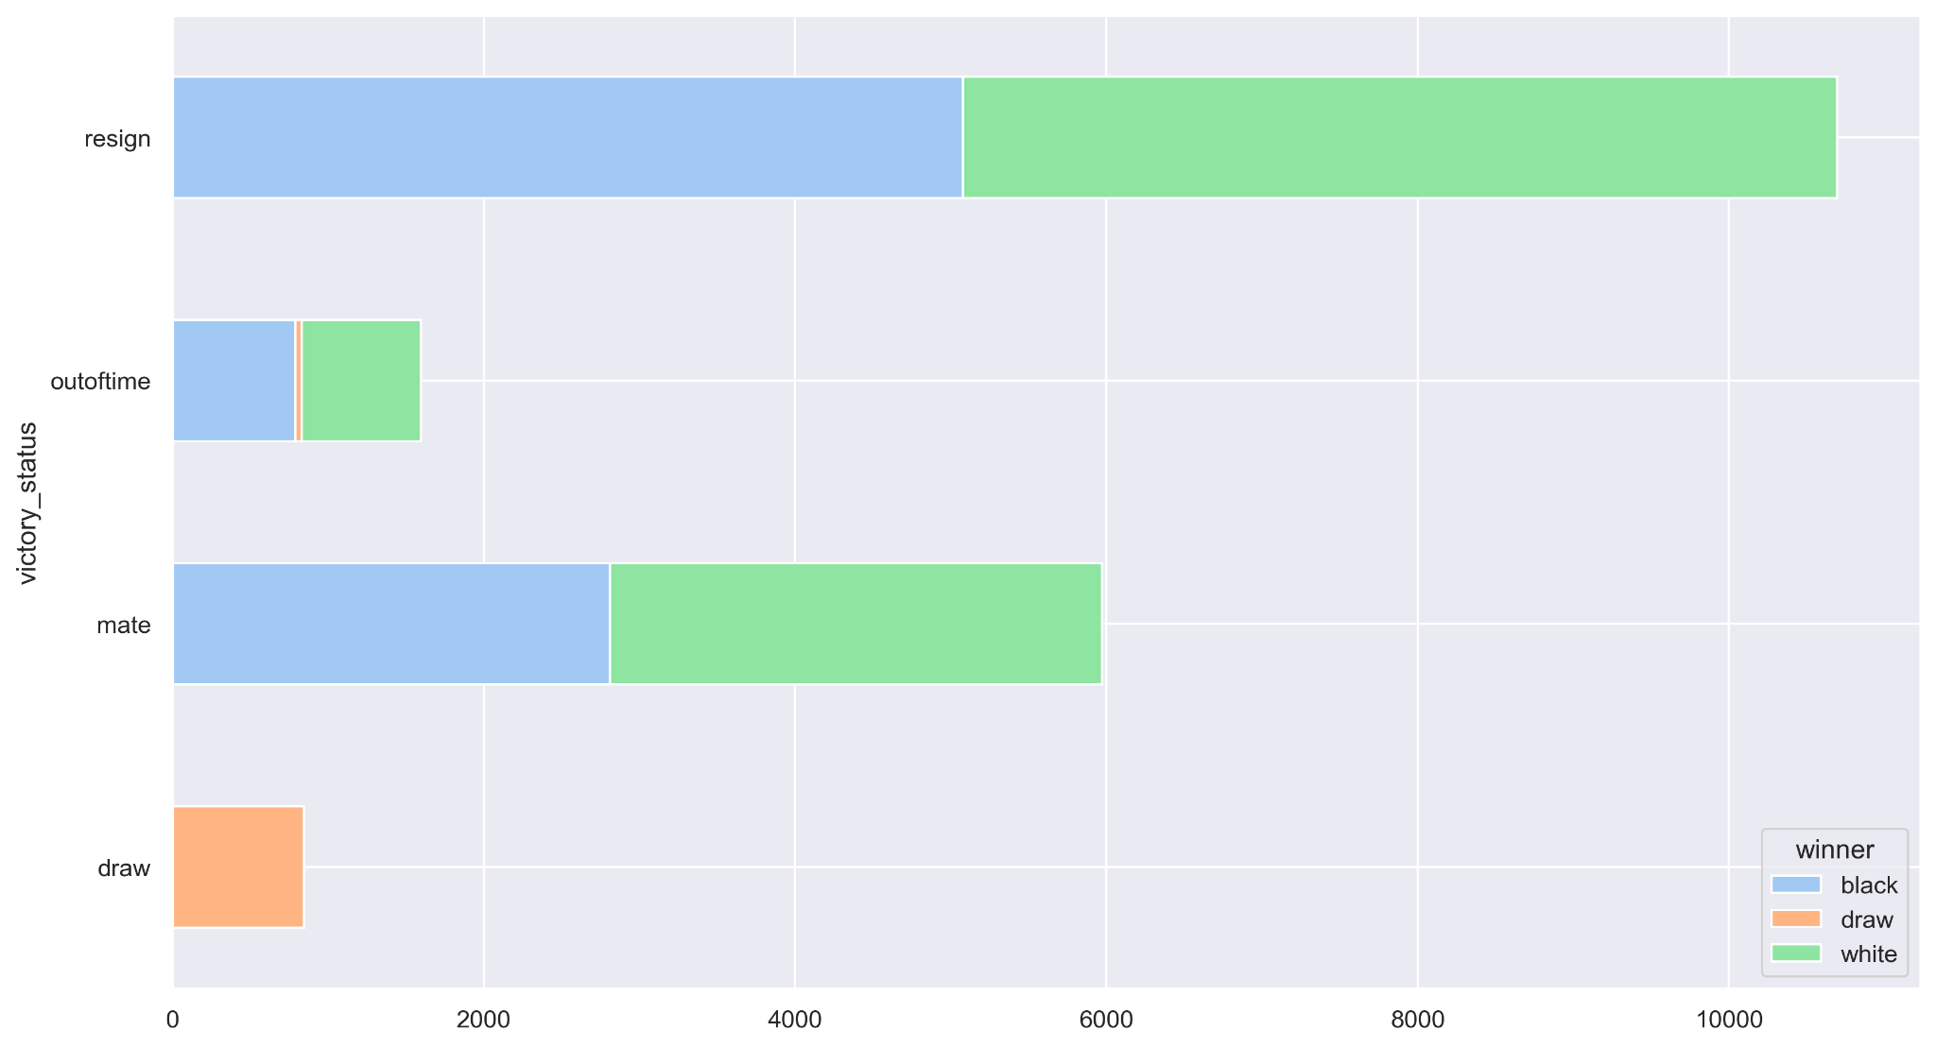
WINNER BY VICTORY STATUS
Players used to resign before the mate

Slide 9
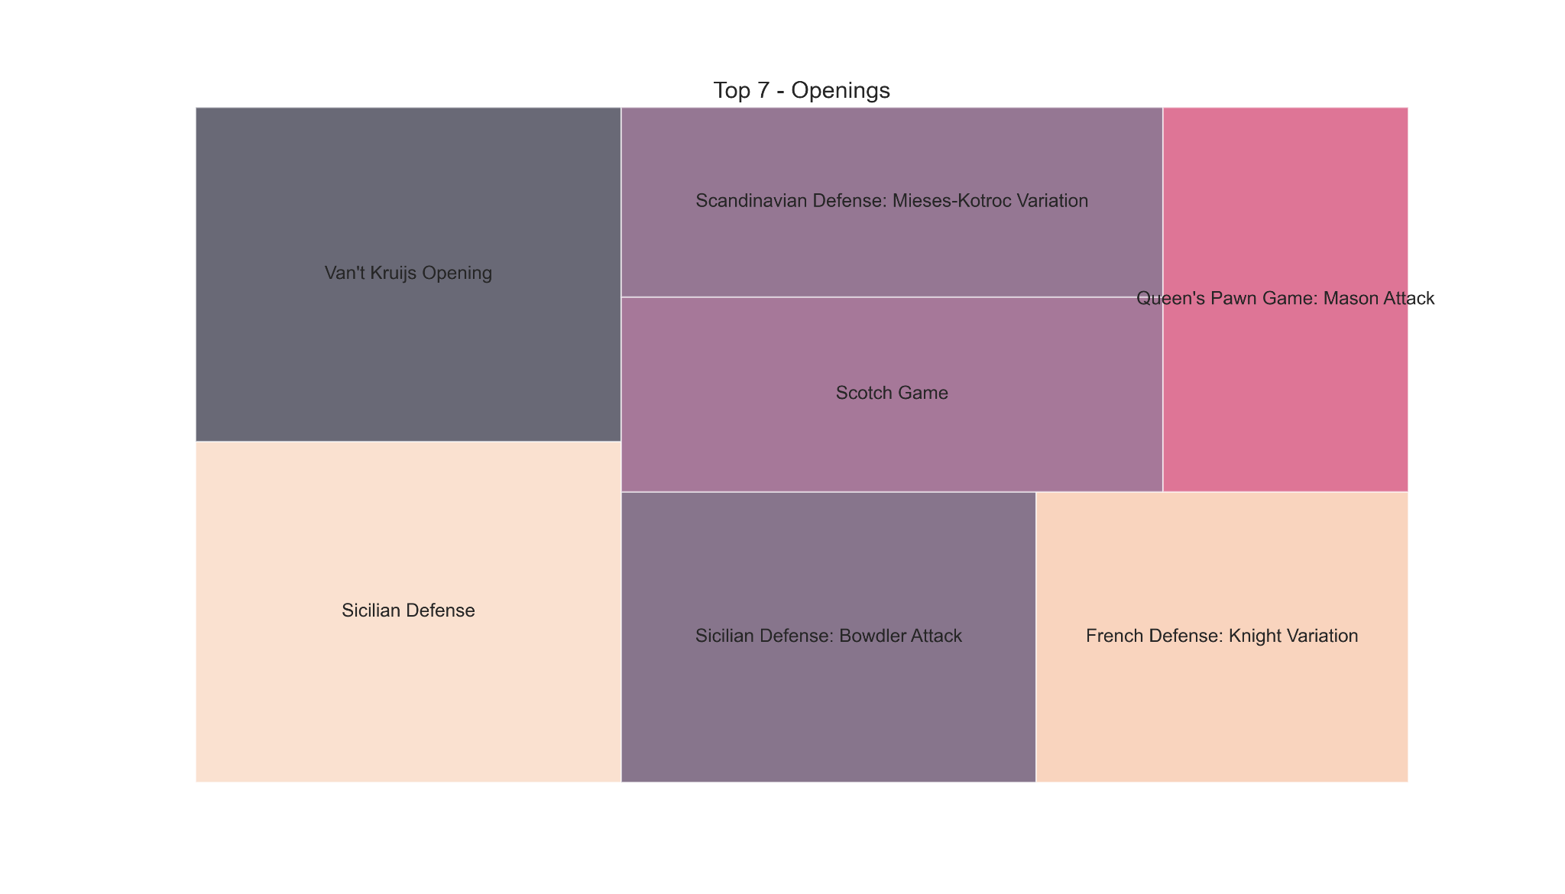
Openings
1477 different openings
Notes:
There is a feature which encode the opening using a chess abbreviation. We had a total of 365 abbreviated openings. We have used that feature for the model. We have dived the value counts of every abbreviated opening by the length of dataset.

Slide 10
Important features for our model
In the next slides, it will be shown some visualizations to better understand the features:
Winner - Target Vector to be predicted
Number of Turns
White Player Rating
Black Player Rating
Opening Eco (Standardised Code for any given opening)

Slide 11
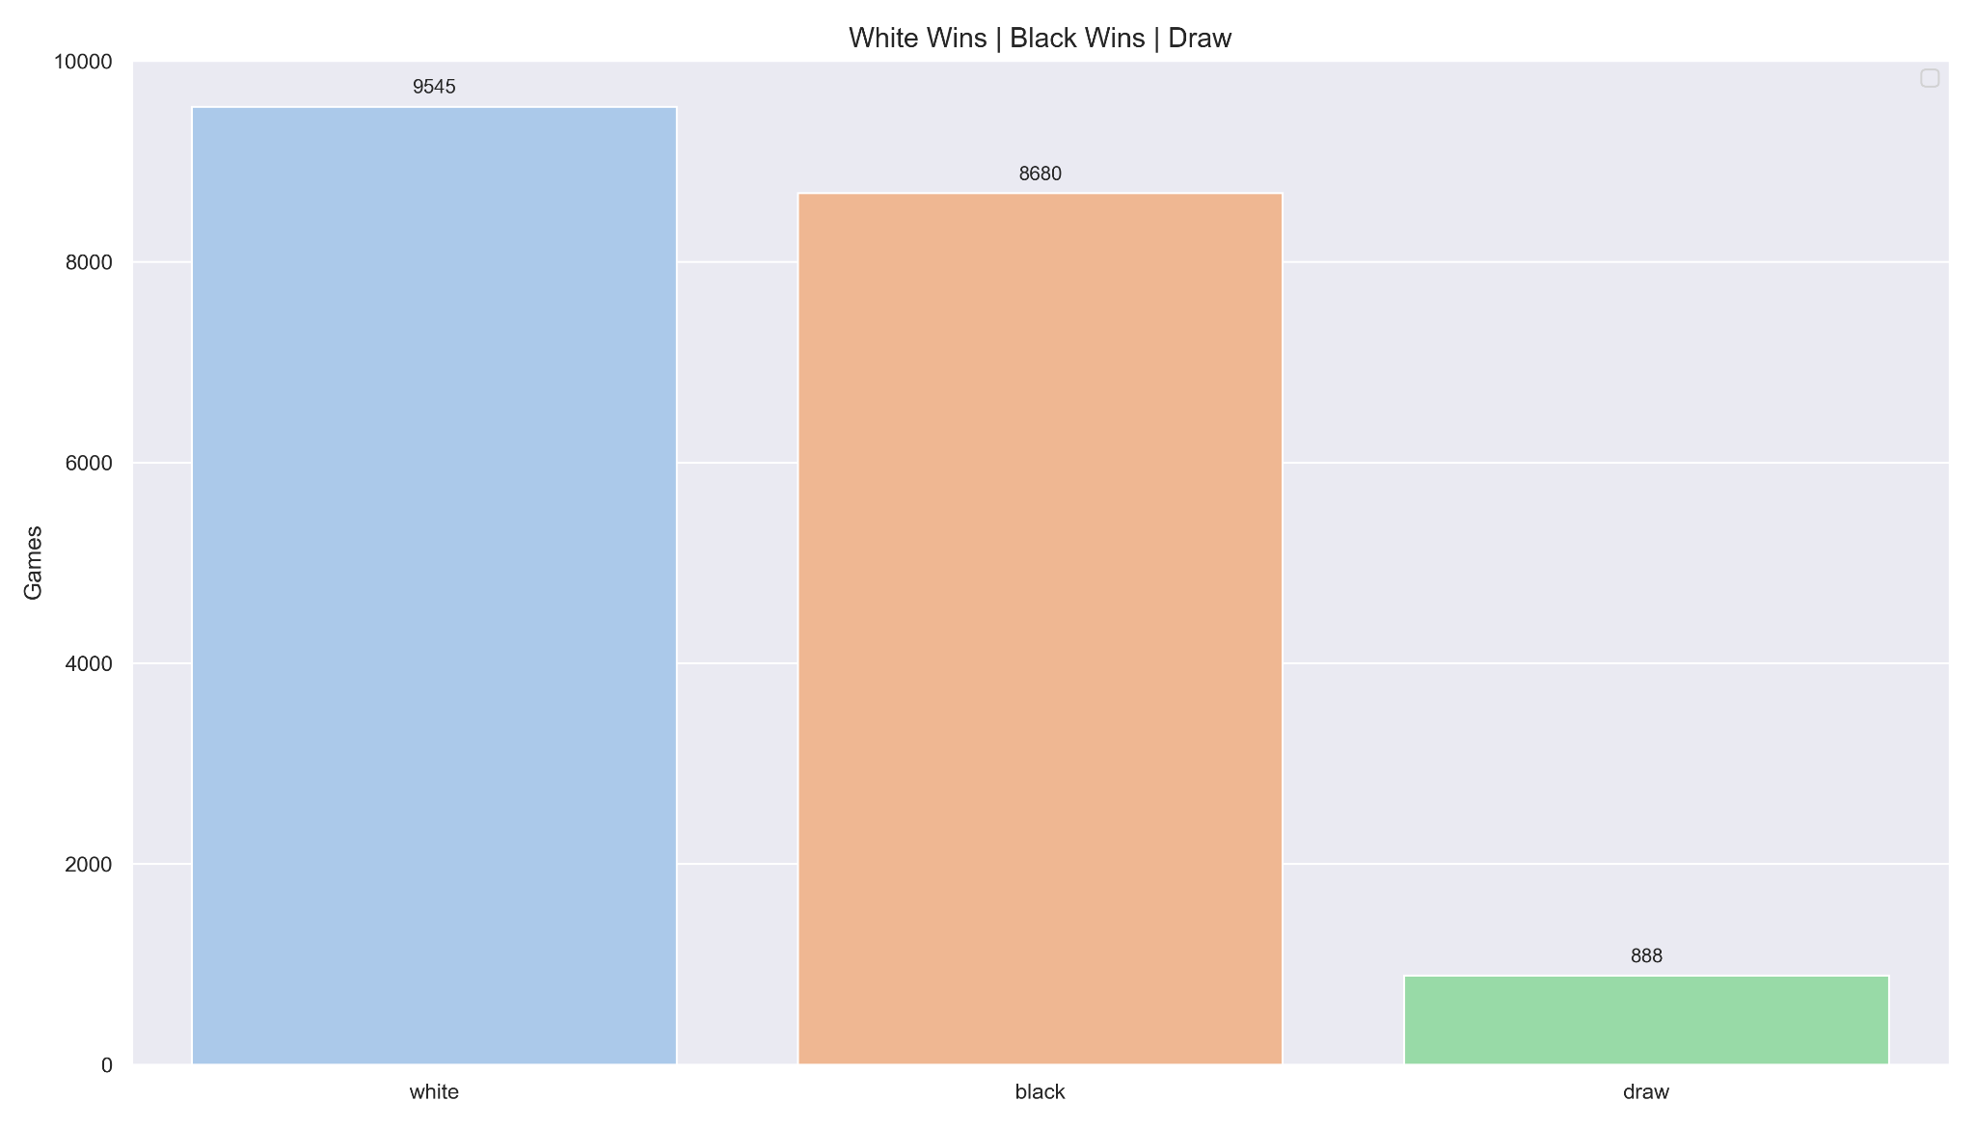
Target vector of prediction : Winner
To have a balanced target vector for our prediction model. We have decided to exclude draw.
Notes:
Most important features for our prediction model.

Slide 12
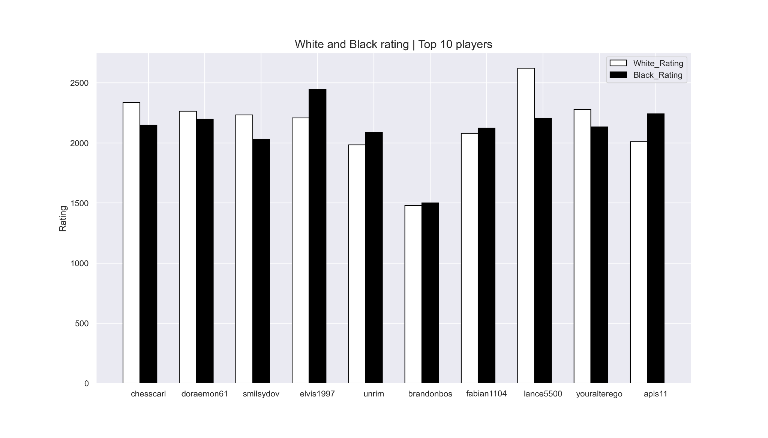
Rating

Slide 13
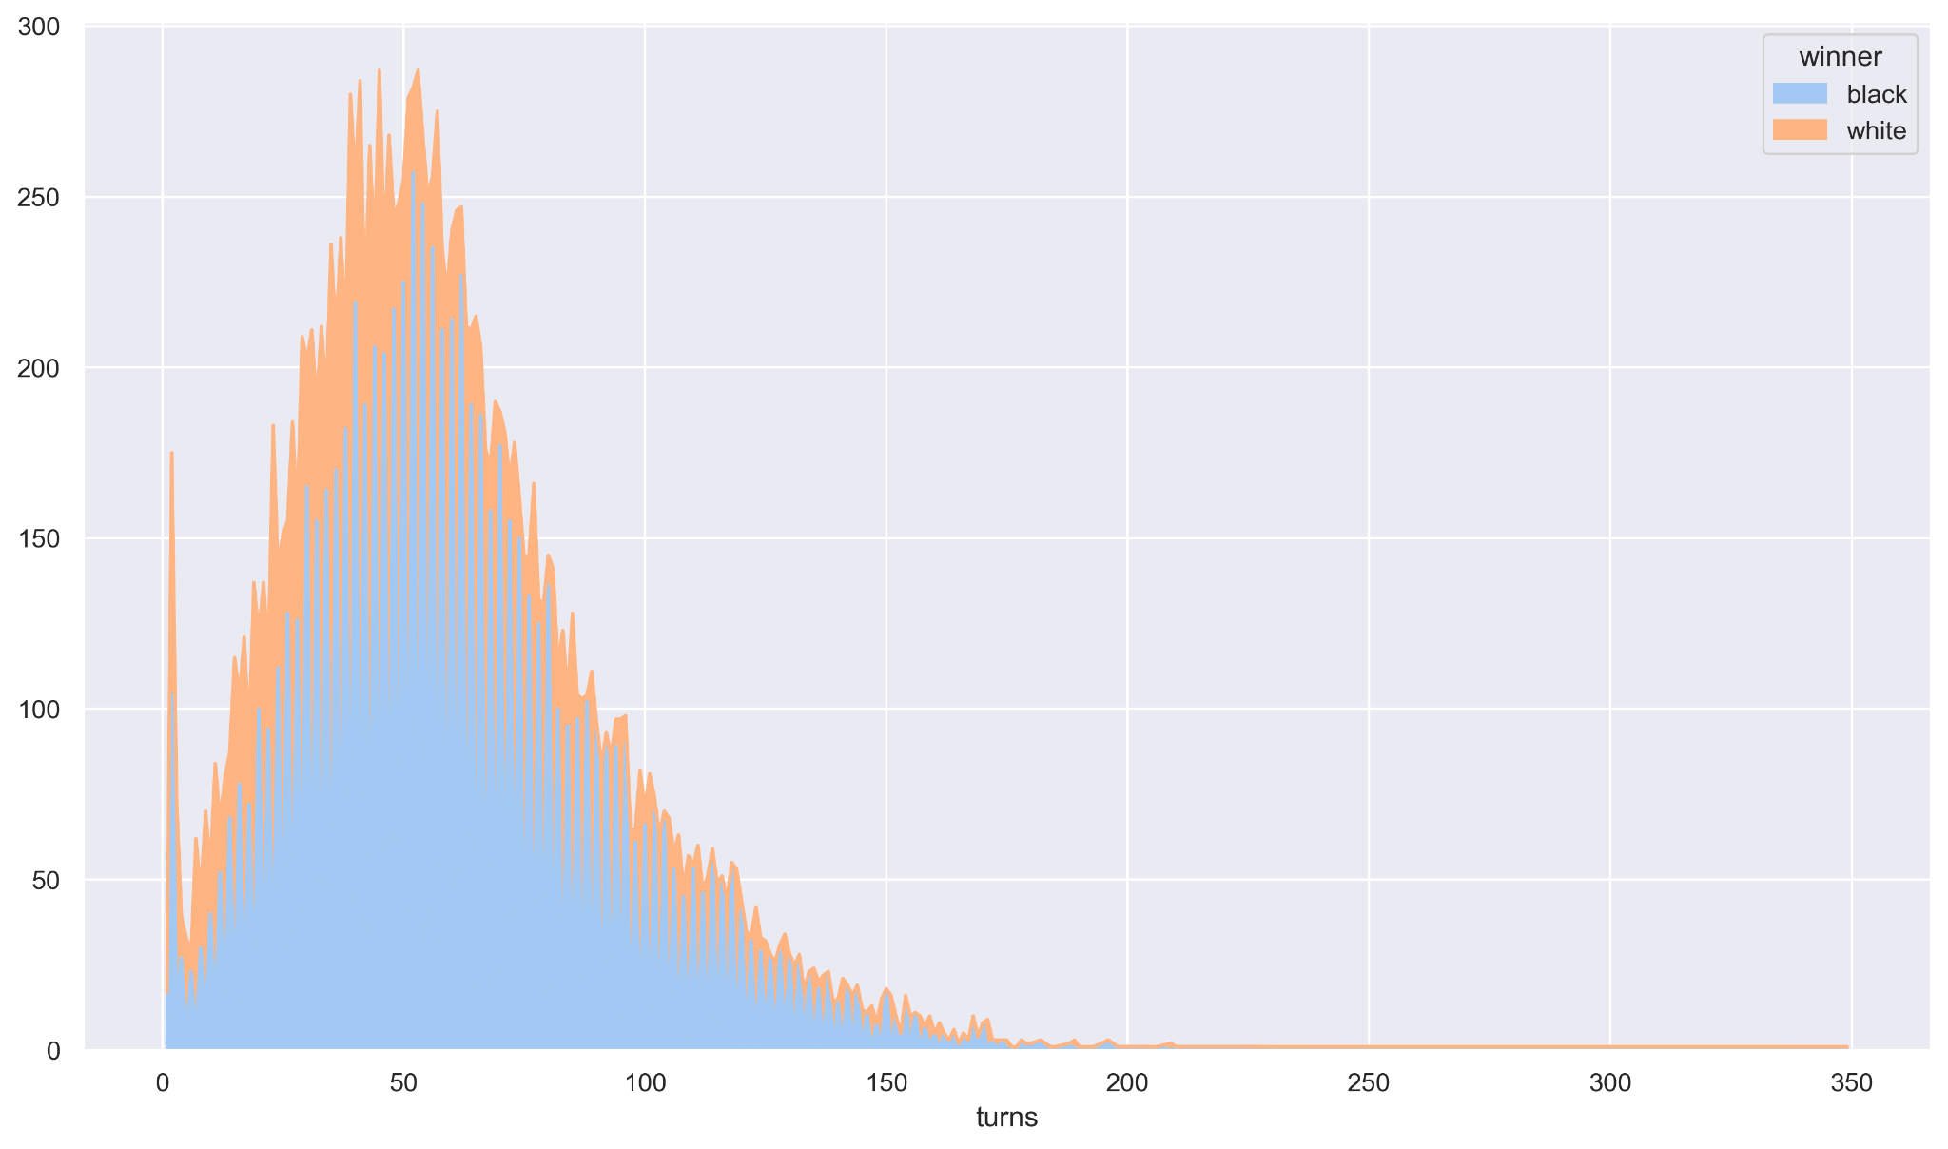
Winner by turns
Whites has more advantage the firsts 60 moves.
Mean = 59 moves
Max= 349 moves
There are outliers

Slide 14
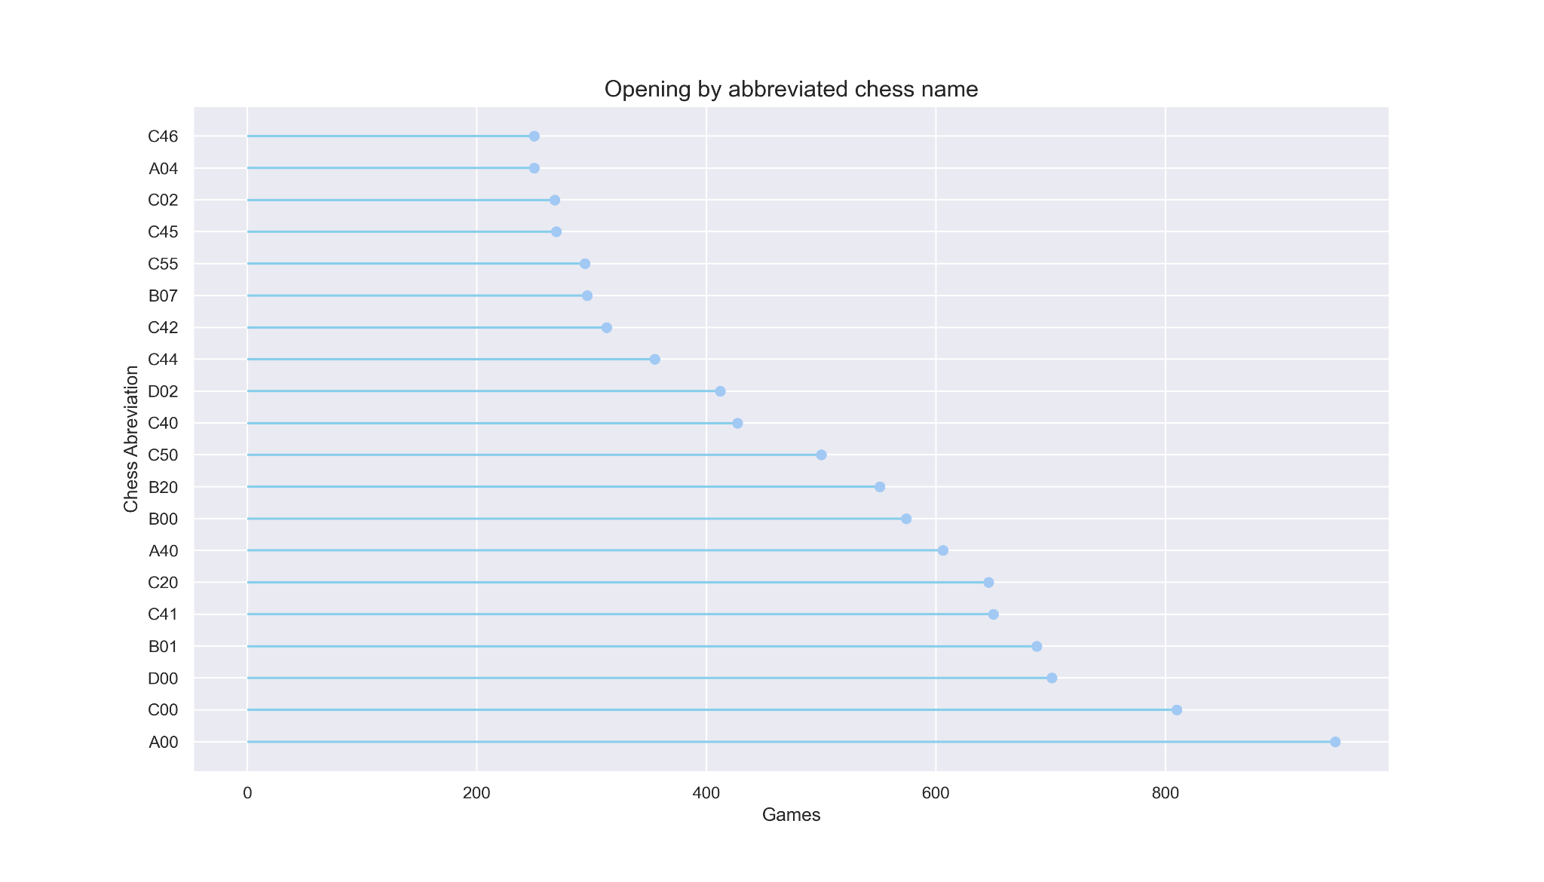
Opening Eco

Slide 15
Ranking, best chess players
Ranking | Player | Games_White | Games_Black | Total_Games | White_Winner | Black_Winner | Total_Wins | Max_White_Rating | Min_White_Rating | Max_Black_Rating | Min_Black_Rating | AVG_Rating
1 | chesscarl | 18 | 28 | 46 | 18 | 27 | 45 | 2336 | 2082 | 2148 | 1344 | 1977.5
2 | doraemon61 | 19 | 23 | 42 | 18 | 20 | 38 | 2264 | 2218 | 2198 | 1455 | 2033.75
3 | smilsydov | 16 | 22 | 38 | 15 | 21 | 36 | 2233 | 1979 | 2030 | 1108 | 1837.5
4 | elvis1997 | 18 | 20 | 38 | 17 | 16 | 33 | 2208 | 2099 | 2446 | 1414 | 2041.75
5 | unrim | 25 | 20 | 45 | 16 | 17 | 33 | 1984 | 1830 | 2087 | 1609 | 1877.5
6 | brandonbos | 23 | 22 | 45 | 17 | 16 | 33 | 1480 | 1480 | 1500 | 944 | 1351
7 | fabian1104 | 21 | 19 | 40 | 18 | 14 | 32 | 2081 | 1844 | 2123 | 1399 | 1861.75
8 | lance5500 | 26 | 15 | 41 | 19 | 12 | 31 | 2621 | 2493 | 2206 | 1122 | 2110.5
9 | youralterego | 18 | 21 | 39 | 14 | 17 | 31 | 2279 | 2183 | 2134 | 1382 | 1994.5
10 | apis11 | 23 | 18 | 41 | 17 | 14 | 31 | 2011 | 1852 | 2241 | 1339 | 1860.75

Slide 16
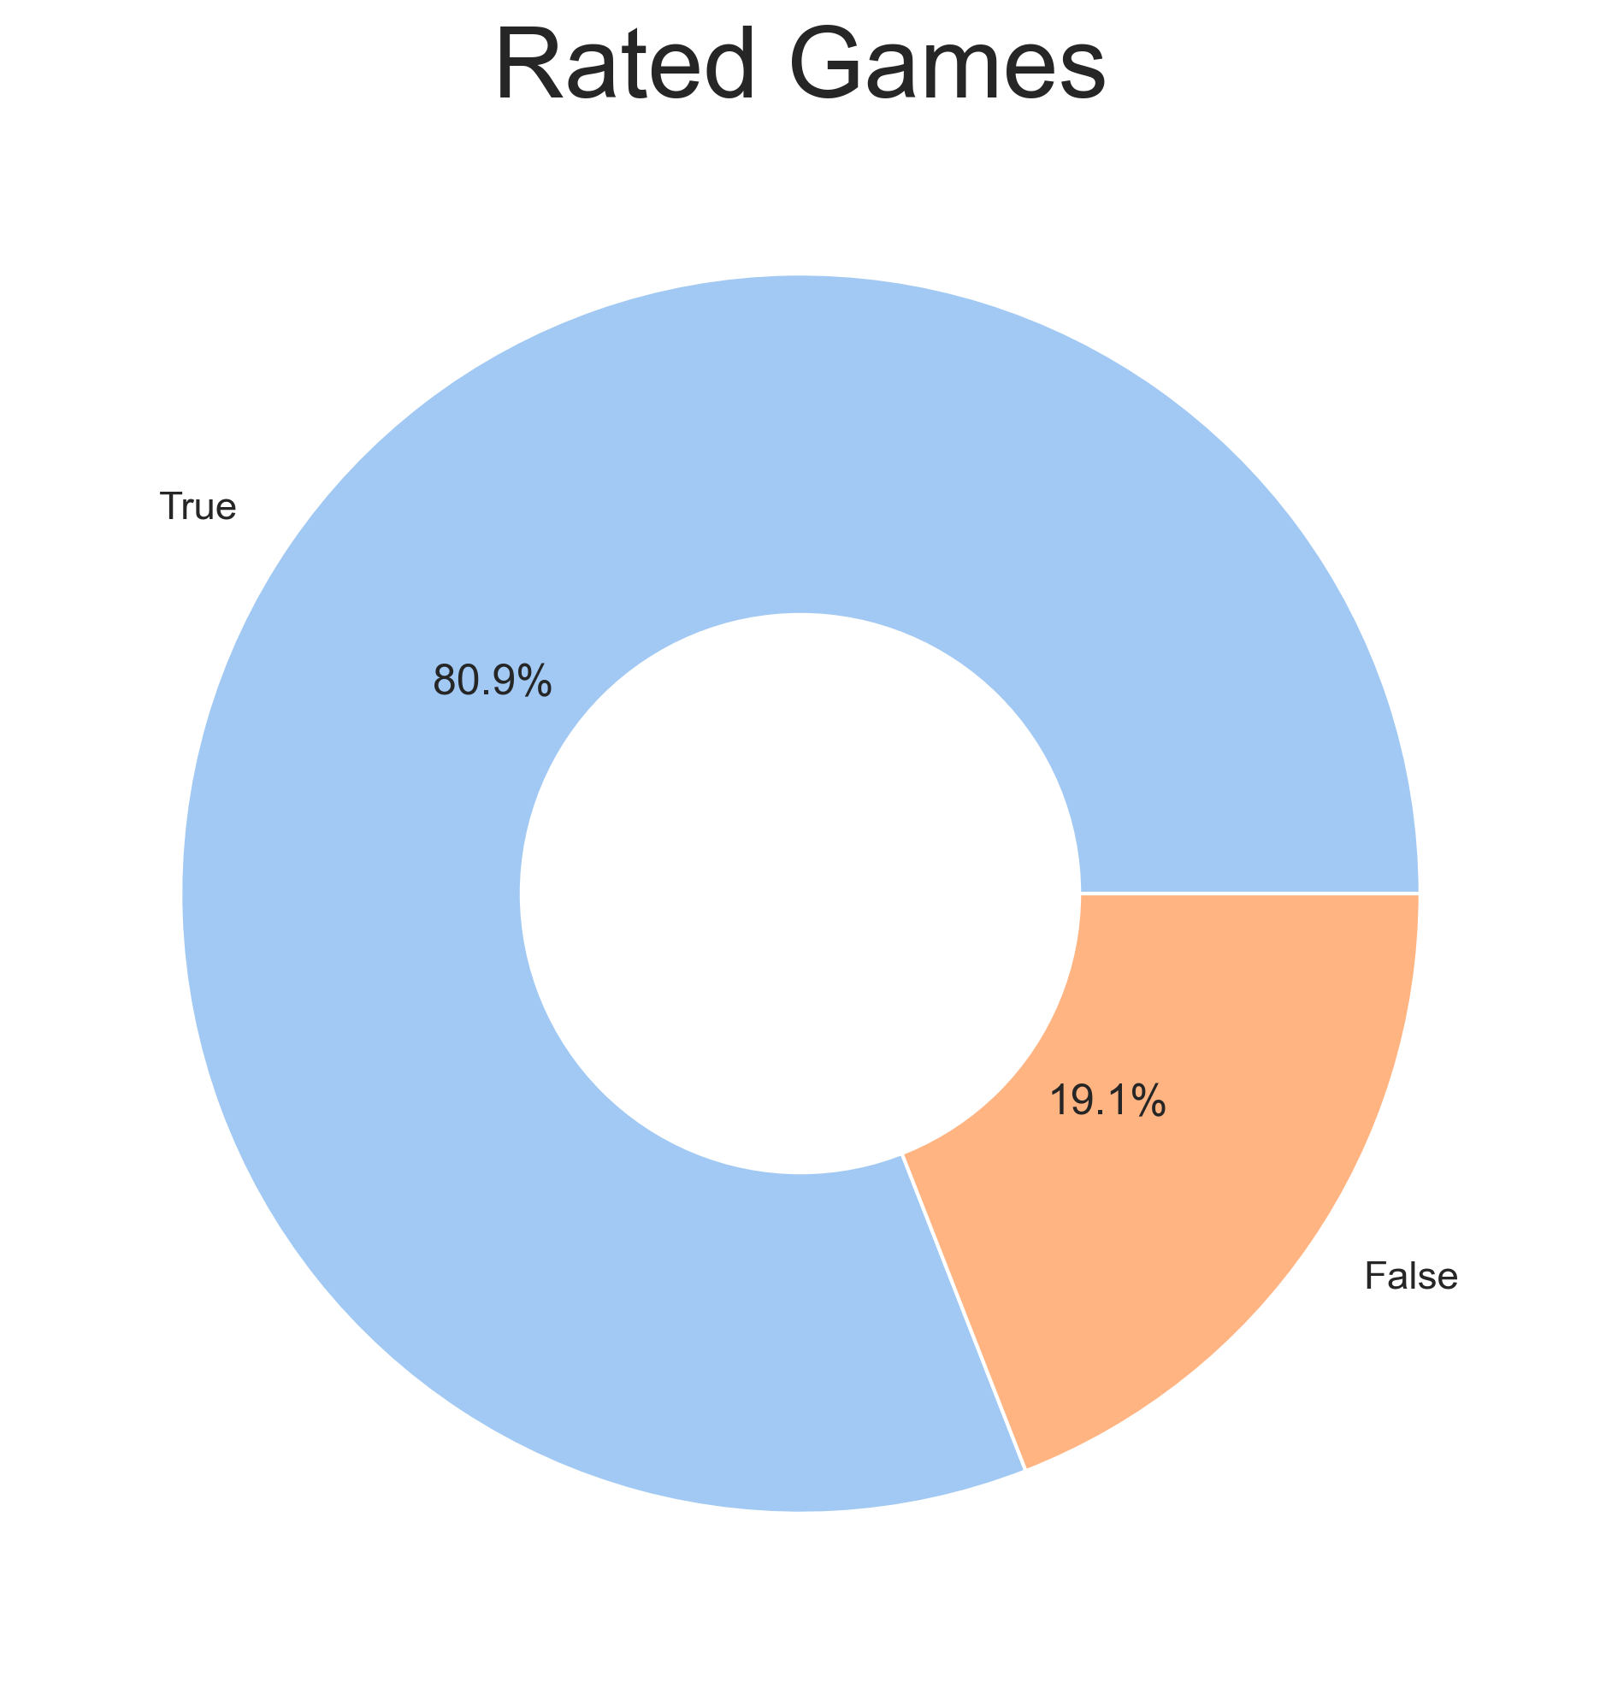

Slide 17
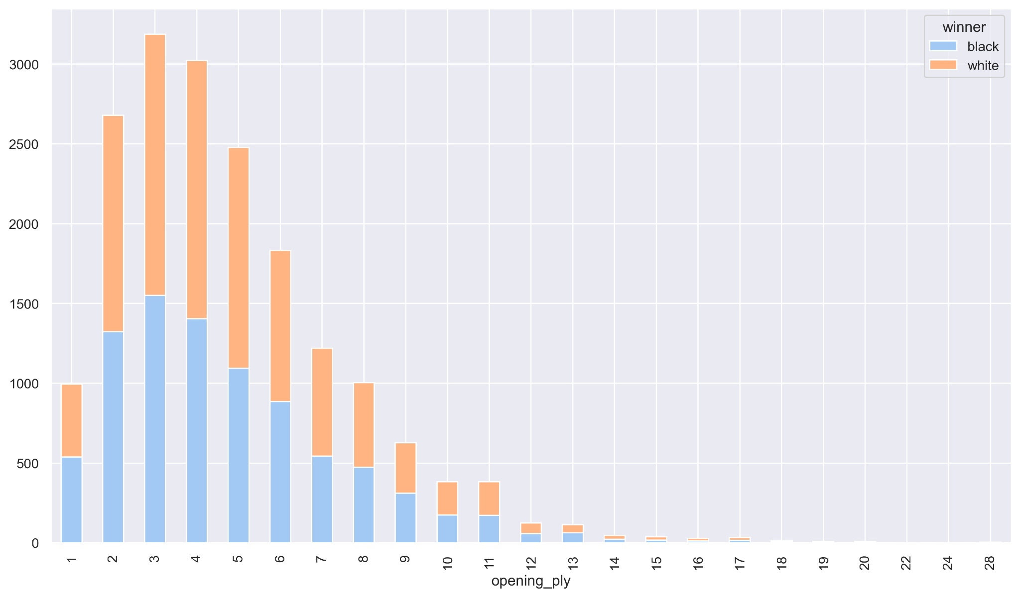
WINNER BY OPENING PLY (Nº movements during the opening phase)
62.3% of the openings are composed for 2,3,4 or 5 movements

Slide 18

Univariate logistic regression model

Slide 19
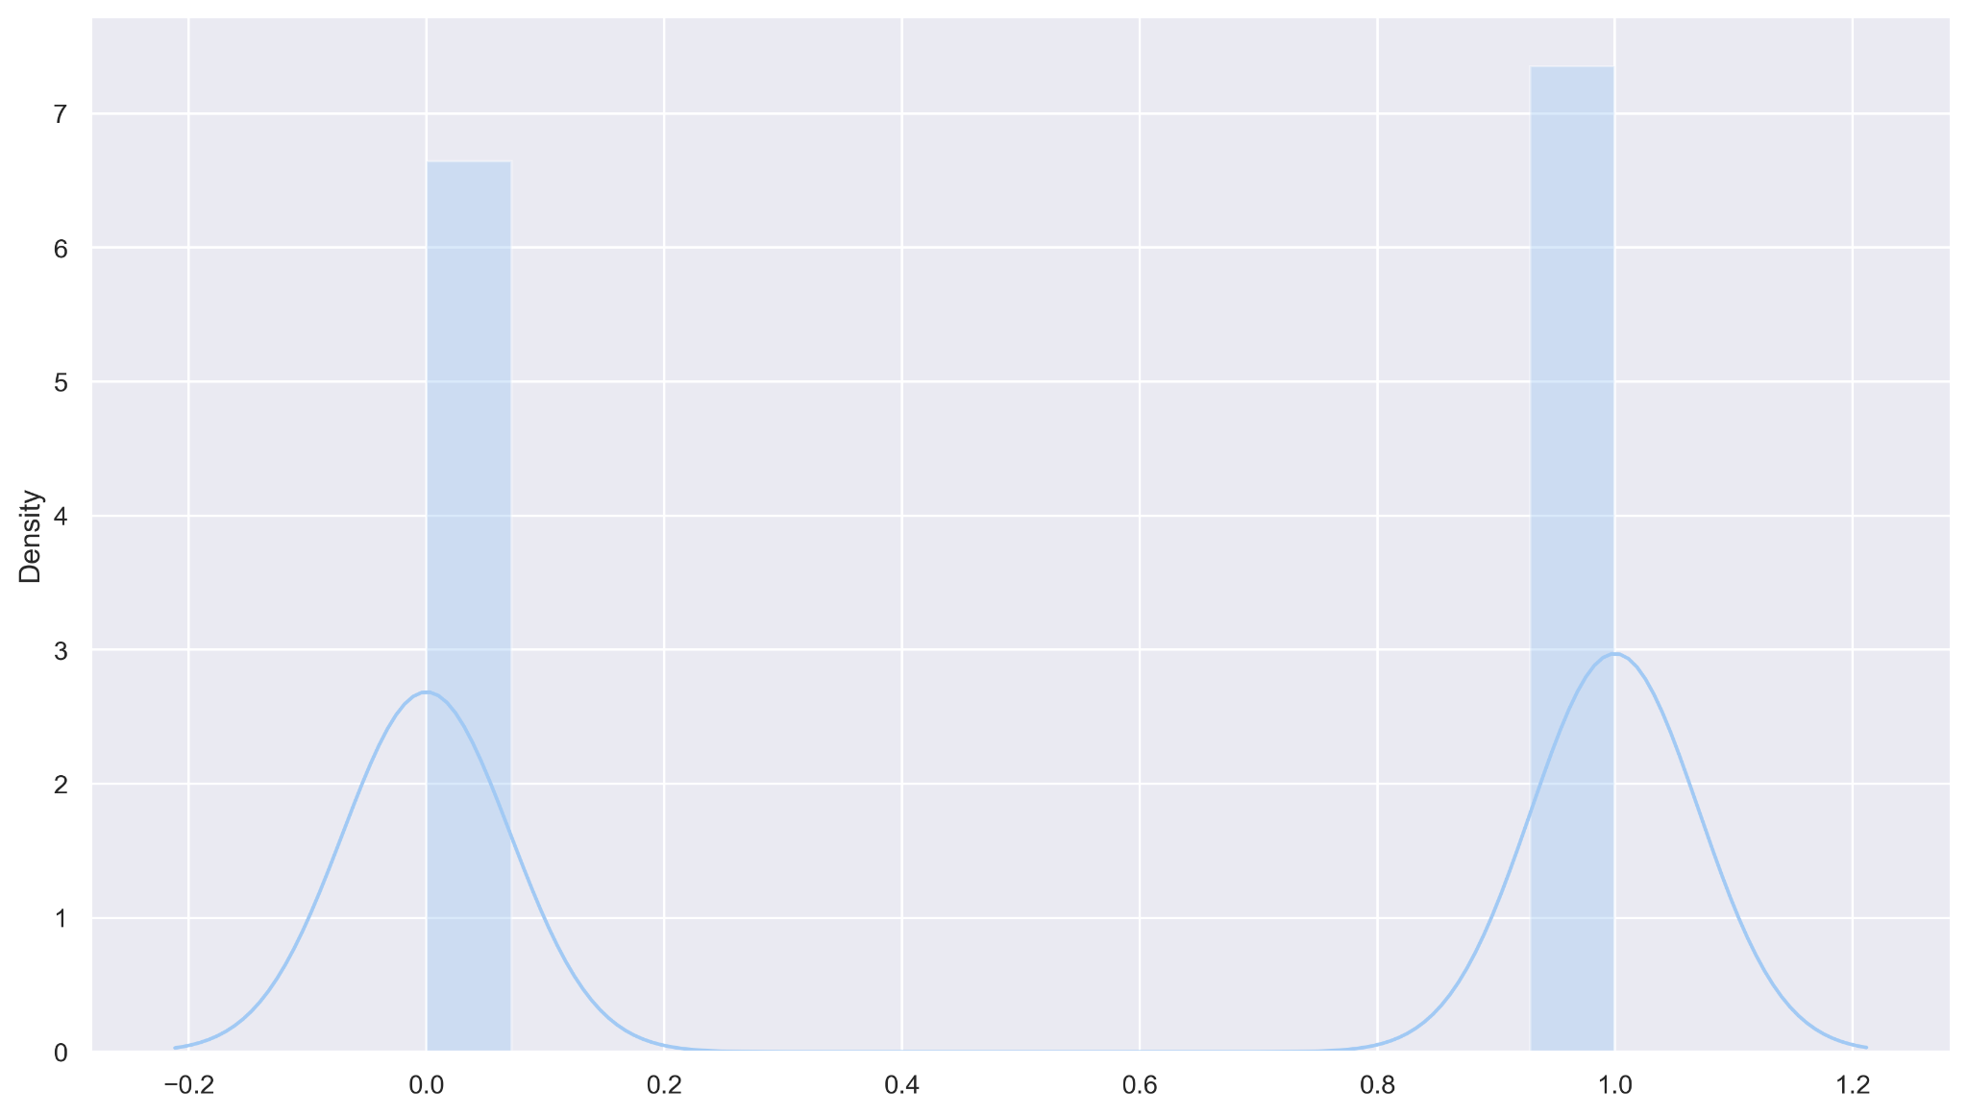
The target value without the draw’s values.
It is appreciated the slight advantage of the whites.
BLACKS WHITES

Slide 20
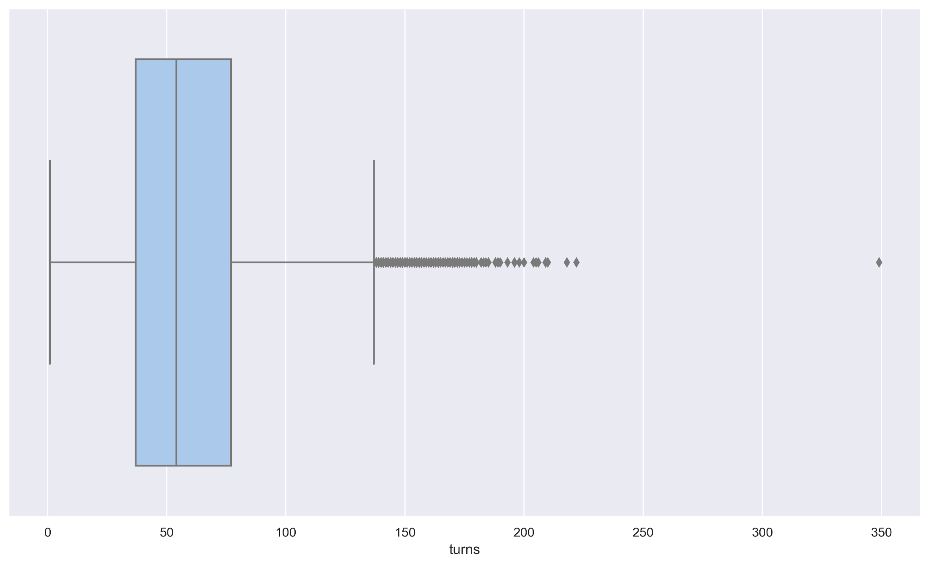
Turn’s outliers

Slide 21
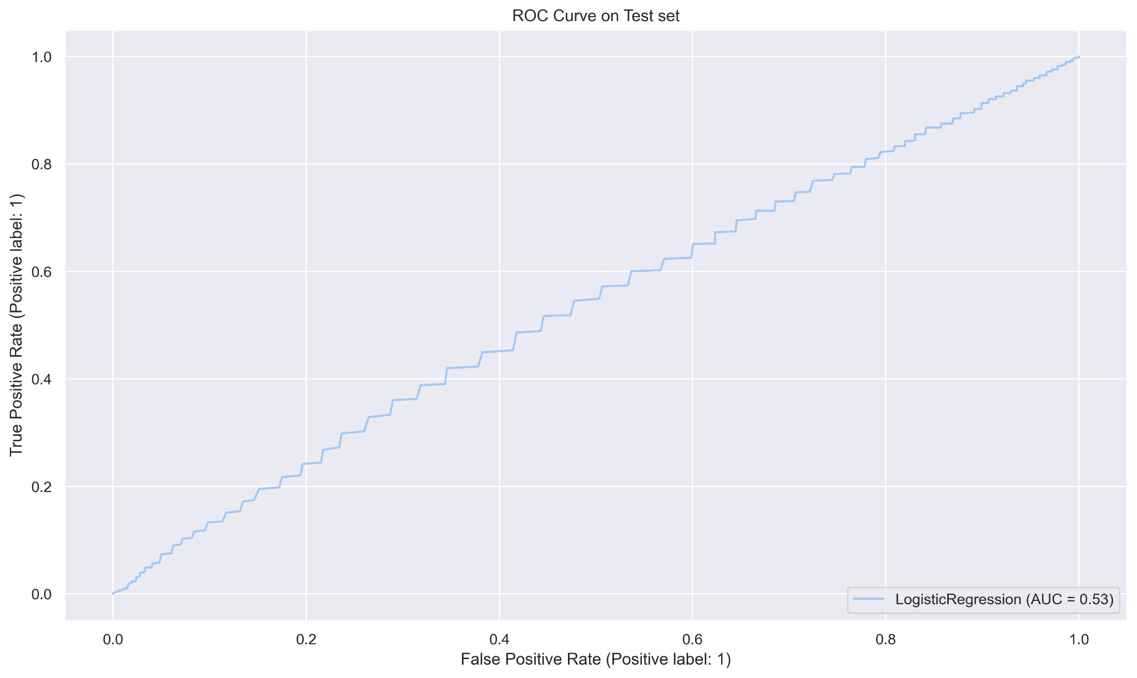
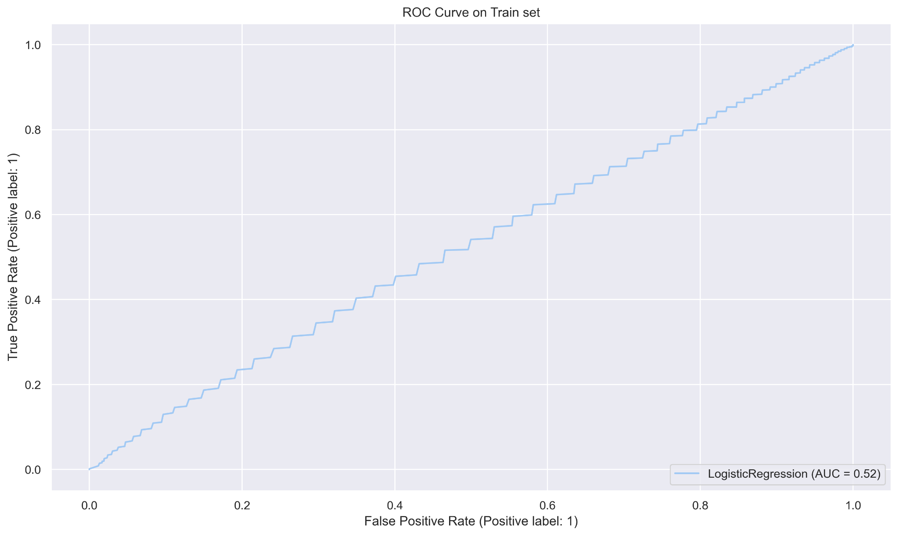
ROC Curve for the univariate logistic regression model
Score very close to 50%

Slide 22

Multivariate logistic regression model

Slide 23
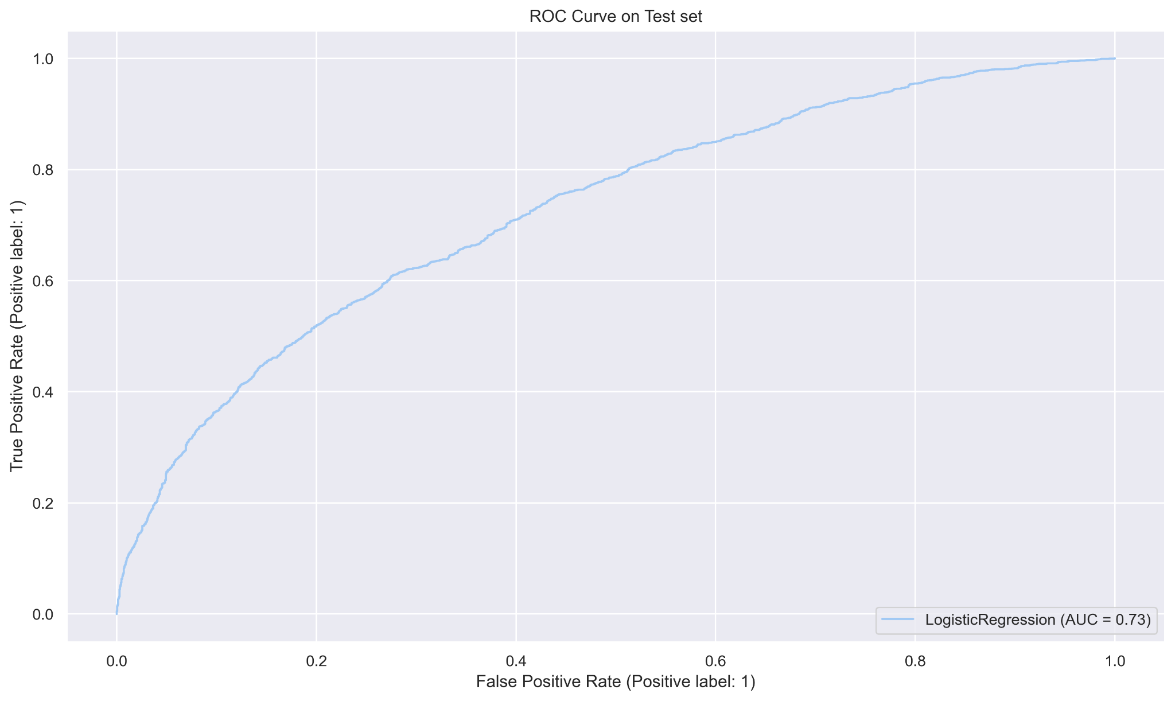
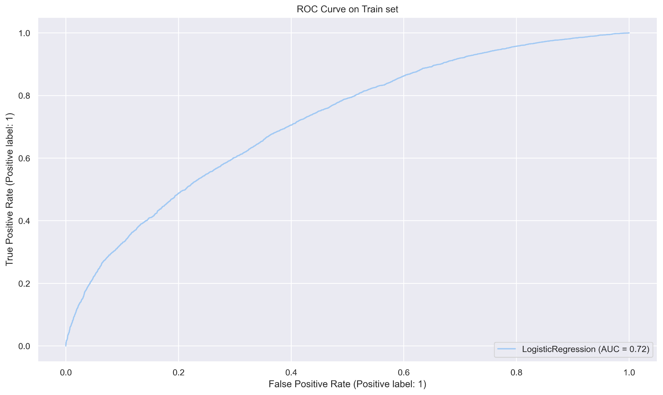
ROC Curve for the multivariate logistic regression model

Slide 24
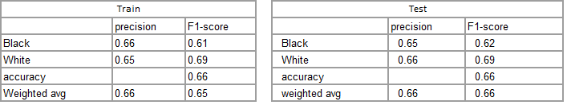
Model Score
Our Model has an accuracy on Train Data and Test Data of 66%
This model generalize well (Neither underfit or overfit) because there is only 1% deviation between the different measures of the model classification report as F1

Slide 25
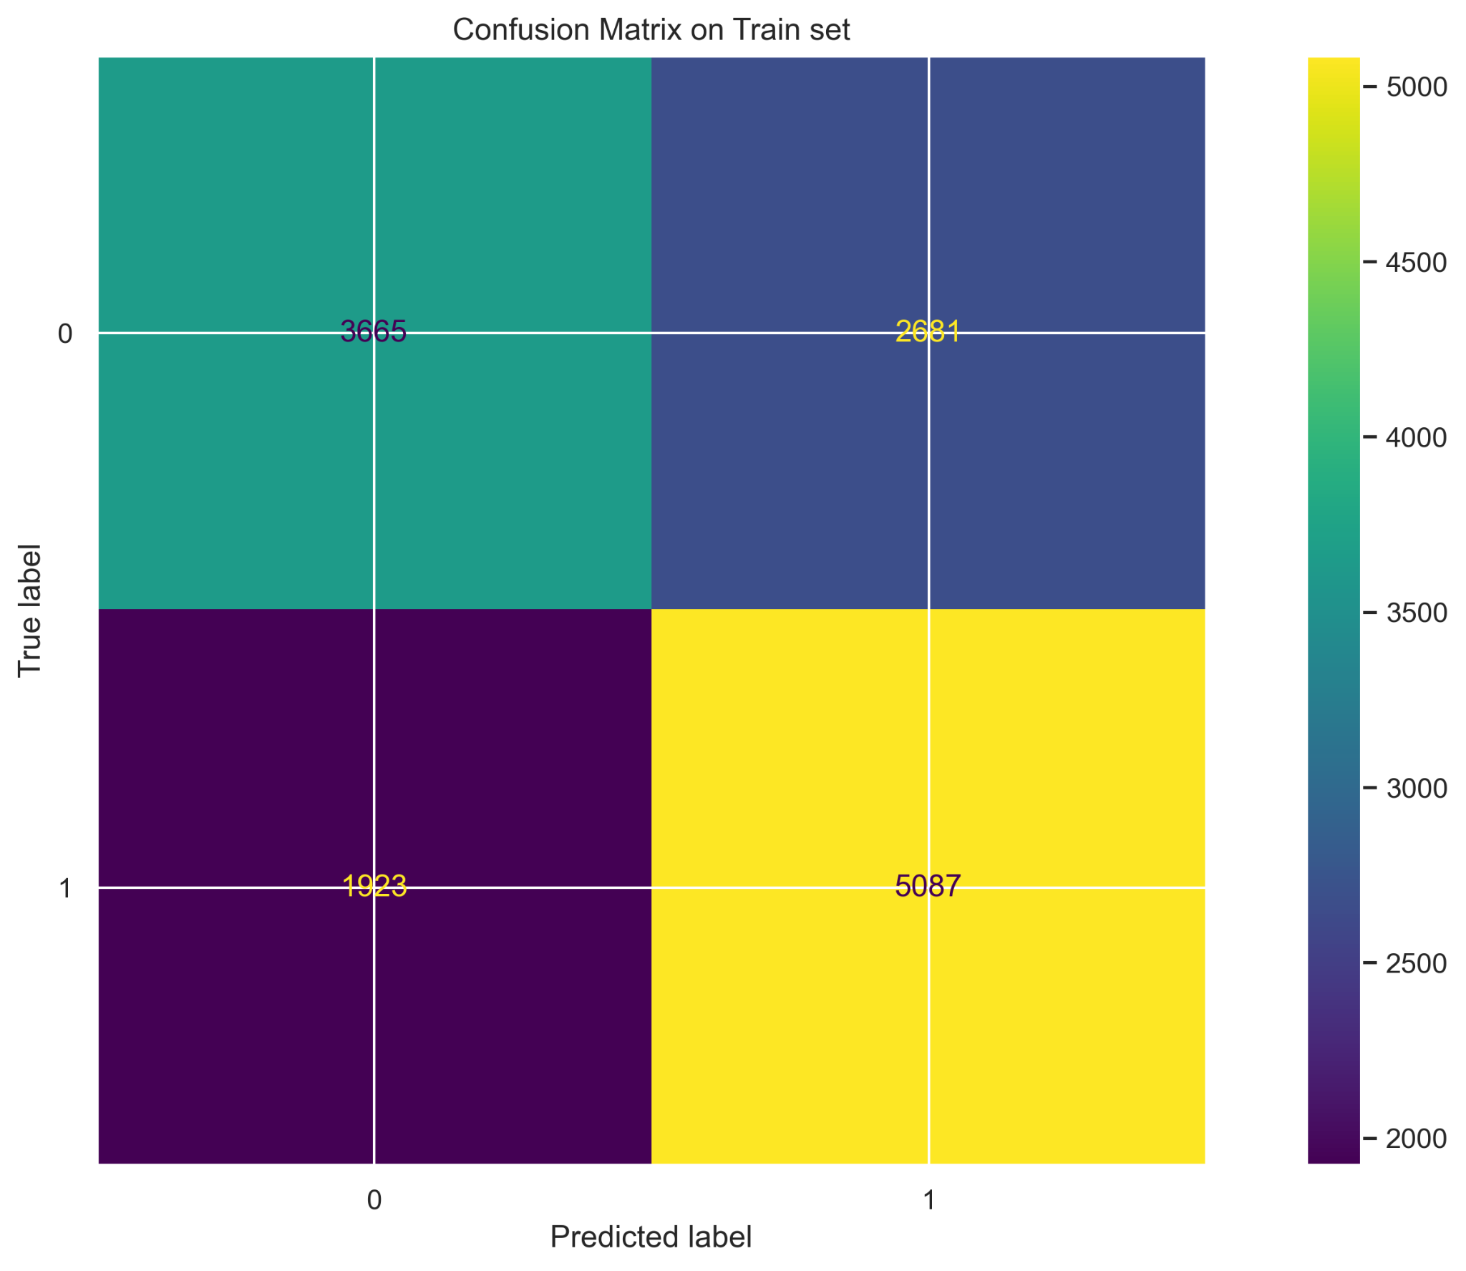

Confusion Matrix

Slide 26
Classification report
TRAIN SET
TEST SET
 | precision | recall | F1-score | support
0 | 0.66 | 0.58 | 0.61 | 6346
1 | 0.65 | 0.73 | 0.69 | 7010
accuracy |  |  | 0.66 | 13356
Macro avg | 0.66 | 0.65 | 0.65 | 13356
Weighted avg | 0.66 | 0.66 | 0.65 | 13356
 | precision | recall | F1-score | support
0 | 0.65 | 0.59 | 0.62 | 2108
1 | 0.66 | 0.72 | 0.69 | 2345
accuracy |  |  | 0.66 | 4453
macro avg | 0.66 | 0.65 | 0.65 | 4453
weighted avg | 0.66 | 0.66 | 0.66 | 4453
Notes:
The accuracy is calculated as the number of exact predictions performed by your model divided by the total number of predictions, in other words the accuracy is the proportion of exact predictions produced by your model.

